Slide 1
Introduction
-Name
-20DECSOFTWARE1 Cohort
-Individual Project
-Goal:
-Fullstack to do List application
-Building on IMS

Slide 2
Consultant Journey
SpringH2 Database + SQL Framework
Junit and Mockito
Integration Testing
Selenium
Sonarqube
Postman
HTML, CSS and JS
Maven

Slide 3
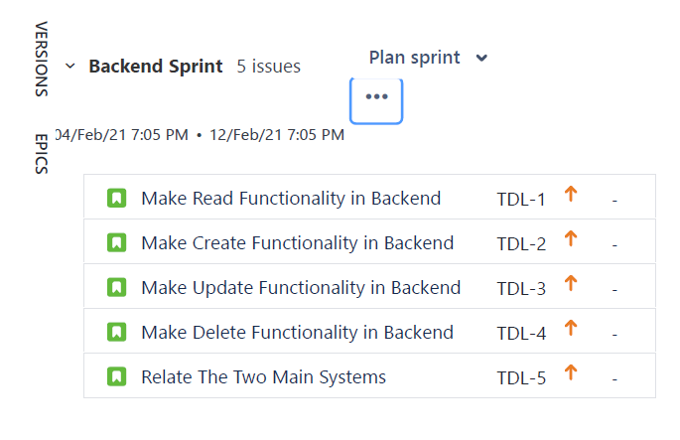
Jira
Four Sprints
Like Features on Git
Backend Testing
Frontend
Frontend Testing

Slide 4
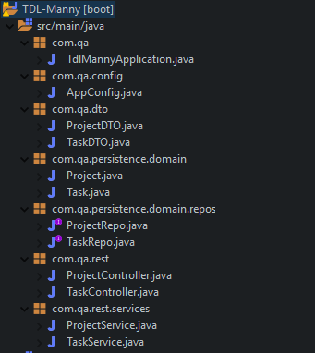
Spring Backend
Several Packages
Domain
Service
DTO
Controller
Repo

Slide 5
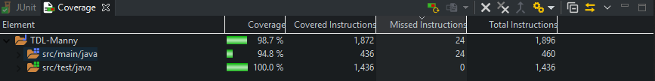
Spring Backend Testing
Testing easier than IMS
Learned Integration Testing

Slide 6
Demonstration
http://localhost:8080/index.html

Slide 7


Sprint Retrospective
Backend > Frontend
Lies Beneath the surface - Iceburg
Improvement in backend abilities
More practice needed on frontend

Slide 8





Questions

